Slide 1
Kotlin
Android Developer Fundamentals

Slide 2
What is Kotlin?

Slide 3
What is Kotlin
Kotlin is a statically typed programming language for Java Virtual Machine (JVM) and JavaScript.
Described as a general purpose language, Kotlin introduces functional features to support Java interoperability.
The Kotlin project was born out of the aspiration for heightened productivity. The goal was to improve the coding experience in a way that was both practical and effective
Kotlin has become a more stable

Slide 4
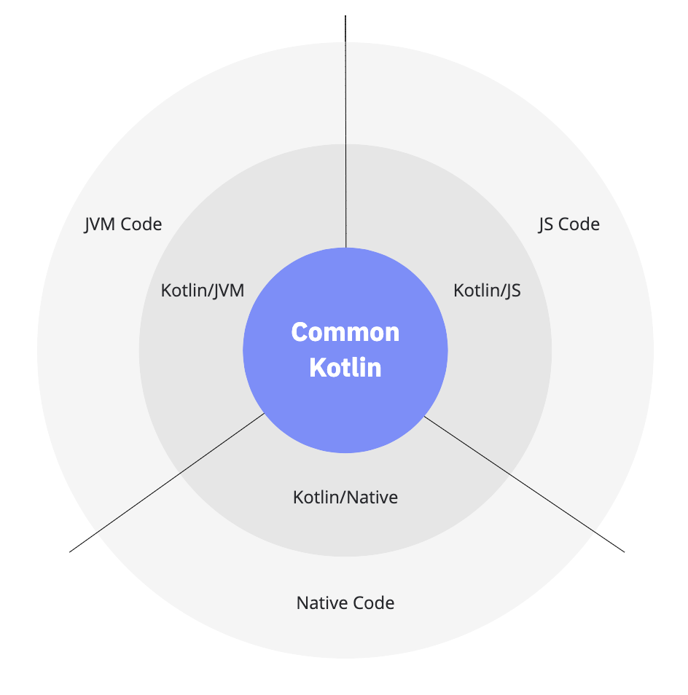
Kotlin Multiplatform works

Slide 5
Basic syntax﻿

Slide 6
Package definition and imports
Package specification should be at the top of the source file.
package my.demo
import kotlin.text.* // ...

Slide 7
Program entry point
An entry point of a Kotlin application is the main function.
fun main() {
println("Hello world!")
}
Another form of main accepts a variable number of String arguments.
fun main(args: Array<String>) {
println(args.contentToString())
}

Slide 8
Variables﻿
Read-only local variables are defined using the keyword val. They can be assigned a value only once.
val a: Int = 1 // immediate assignment
val b = 2 // `Int` type is inferred
val c: Int // Type required when no initializer is provided
c = 3 // deferred assignment
Variables that can be reassigned use the var keyword.
var x = 5 // `Int` type is inferred
x += 1

Slide 9
Visibility modifiers﻿
Classes, objects, interfaces, constructors, and functions, as well as properties and their setters, can have visibility modifiers. Getters always have the same visibility as their properties.
Private: t will only be visible inside the file that contains the declaration
Protected: the same visibility as one marked as private, but that it is also visible in subclasses.
Internal: it will be visible everywhere in the same module
Public (open): declarations will be visible everywhere
Visibility modifiers | Kotlin (kotlinlang.org)

Slide 10
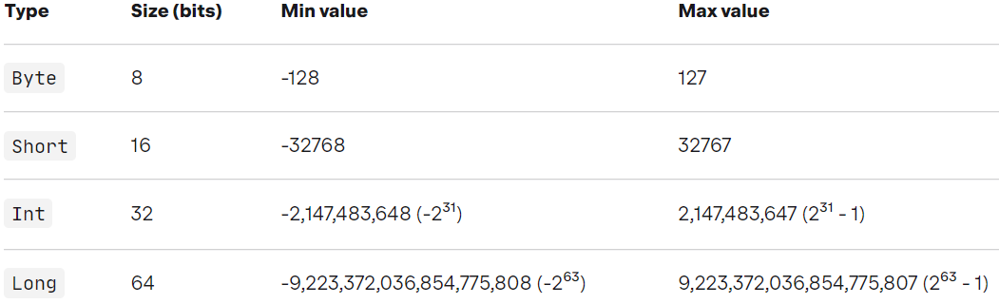
Built-in data types - Numbers

Slide 11
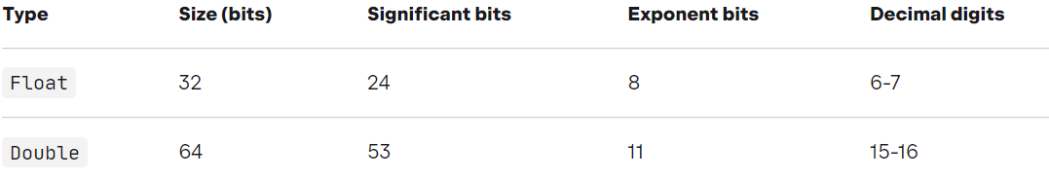
Built-in data types -Floating-point

Slide 12
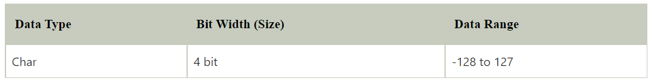
Built-in data types - Character

Slide 13
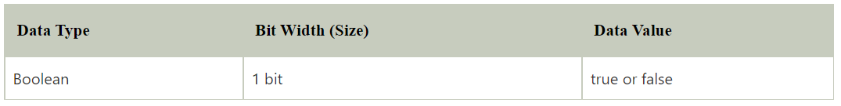
Built-in data types - Boolean

Slide 14
Built-in data types - String
val text ="Hello, Kotlin"

Slide 15
Built-in data types -
https://kotlinlang.org/docs/basic-types.html

Slide 16
Anatomy of an if statement.
if (a > b) {
return a
} else {
return b
}
fun maxOf(a: Int, b: Int) = if (a > b) a else b

Slide 17
Anatomy of a while loop.
while (index < items.size) {
println("item at $index is ${items[index]}")
index++
}

Slide 18
Anatomy of a for loop.
val items = listOf("apple", "banana", "kiwifruit")
for (item in items) {
println(item)
}
for (index in items.indices) {
println("item at $index is ${items[index]}")
}

Slide 19
Switch statement.
when (obj) {
1 -> "One"
"Hello" -> "Greeting"
is Long -> "Long"
!is String -> "Not a string"
else -> "Unknown"
}

Slide 20
Classes﻿

Slide 21
Classes
To define a class, use the class keyword.
class Shape
Properties of a class can be listed in its declaration or body.
class Rectangle(var height: Double, var length: Double) { var perimeter = (height + length) * 2 }

Slide 22
Classes
By default, classes in Kotlin are final, which means it cannot be subclassed.
By using the open annotation on a class, compiler allows you to derive new classes from it

Slide 23
Classes
Inheritance between classes is declared by a colon (:).
Classes are final by default;
To make a class inheritable, mark it as open.
open class Shape {……} // Implicitly inherits from Any

Slide 24
Constructors﻿
A class can have a primary constructor and one or more secondary constructors.
The primary constructor is a part of the class header, and it goes after the class name and optional type parameters.
class Person constructor(firstName: String) { /*...*/ }
The constructor keyword can be omitted

Slide 25
Constructors﻿
The primary constructor cannot contain any code.
Initialization code can be placed in initializer blocks prefixed with the init keyword
The initializer blocks are executed in the same order as they appear in the class body
Primary constructor parameters can be used in the initializer blocks.
They can also be used in property initializers declared in the class body
class Customer(name: String) { val customerKey = name.uppercase() }

Slide 26
Constructors﻿
Examples
class Person(val firstName: String, val lastName: String, var age: Int)
class Person(val firstName: String, val lastName: String, var isEmployed: Boolean = true)
class Person( val firstName: String, val lastName: String, var age: Int, // trailing comma ) { /*...*/ }
class C private constructor(a: Int) { ... }
class Rectangle(var height: Double, var length: Double): Shape() { var perimeter = (height + length) * 2 }

Slide 27
Secondary Constructors﻿
Prefixed with constructor
Code in initializer blocks effectively becomes part of the primary constructor
class Person(val name: String) { val children: MutableList<Person> = mutableListOf() constructor(name: String, parent: Person) : this(name)
{ parent.children.add(this) } }

Slide 28
Functions
A function with two Int parameters and Int return type.
fun sum(a: Int, b: Int): Int {
return a + b
}
A function body can be an expression. Its return type is inferred.
fun sum(a: Int, b: Int) = a + b

Slide 29
Functions
A function that returns no meaningful value.
fun printSum(a: Int, b: Int): Unit {
println("sum of $a and $b is ${a + b}")
}
Unit return type can be omitted.
fun printSum(a: Int, b: Int) {
println("sum of $a and $b is ${a + b}")
}
To override the member function of the derived class using override keyword, and use open keyword for the member function of the base class

Slide 30
Implementation
open class Person() {
open fun displayAge(age: Int) {
println("My actual age is $age.")
}
}
class Girl: Person() {
override fun displayAge(age: Int) {
// calling function of base class
super.displayAge(age)
println("My fake age is ${age - 5}.")
}
}
fun main(args: Array<String>) {
val girl = Girl()
girl.displayAge(31)
}

Slide 31
Kotlin classes
simple class
empty class
primary constructor
open class
data class
nested class: A nested class cannot access the members of the outer class.
inner class
abstract class
sealed class
https://zetcode.com/kotlin/classes/

Slide 32
Concept Summary

Slide 33
Concept Summary
Object - Objects do the action in an object-oriented program. An object can have things it knows (properties) and things it can do (functions). An object is created by a class and keeps a reference to the class that created it.

Slide 34
Concept Summary cont…
Class - A class defines what all objects of that class know (fields) and can do (methods). You can also have data and behavior in the object that represents the class (class fields and methods). All objects of a class have access to class fields and class methods, but these can also be accessed using className.field or className.method().

Slide 35
Concept Summary cont…
Inheritance - One class can inherit object fields and methods from another. This makes it easy to reuse another class by extending it (inheriting from it). This is called specialization. You can also pull out common fields and/or methods from several related classes and put those in a common parent class. This is called generalization.

Slide 36
Concept Summary cont…
Polymorphism - The runtime type of an object can be that type or any subclass of the declared type. All method calls are resolved starting with the class that created the object. If the method isn’t found in the class that created the object, then it will look in the parent class and keep looking up the inheritance tree until it finds the method. The method must exist, or the code would not have complied.

Slide 37
Concept Summary cont…
Parent Class - One class can inherit from another and the class that it is inheriting from is called the parent class. The parent class is specified in the class declaration using the : followed by the parent class name.

Slide 38
Concept Summary cont…
Child Class - The class that is doing the inheriting is called the child class. It inherits access to the object fields and methods in the parent class.
Subclass - A child class is also called a subclass.
Superclass - A parent class is also called a superclass.

Slide 39
Concept Summary cont…
overrides - A child class can have the same method signature (method name and parameter list) as a parent class. Since methods are resolved starting with the class that created the object, that method will be called instead of the inherited parent method, so the child method overrides the parent method.

Slide 40
Concept Summary cont…
overload - At least two methods with the same name but different parameter lists. The parameter lists can differ by the number of parameters and/or the types.

Slide 41
Concept Summary cont…
abstract class - A class that is used as a common parent for several child classes, that typically has at least one abstract method, but can also have fields and non-abstract methods. You can not create an object of an abstract class, but must create an object of a concrete (not-abstract) child class.

Slide 42
Concept Summary cont…
interface - A special type of abstract class that can only have public class constants and public abstract methods. These are useful for separating what a class is from what it does.

Slide 43
Learn more
https://kotlinlang.org/
Kotlin let, run, also, apply, with
Constructors
Inheritance
Google it ☺

Slide 44
END

